Slide 1

CHAPTER 12
REGULAR
EXPRESSIONS
AND FINITE-STATE
AUTOMATA
Copyright © Cengage Learning. All rights reserved.

Slide 2
SECTION 12.2
Finite-State Automata
Copyright © Cengage Learning. All rights reserved.

Slide 3
Finite-State Automata
Gates can be combined into circuits in a variety of ways. If the rules shown below are obeyed, the result is a combinational circuit, one whose output at any time is determined entirely by its input at that time without regard to previous inputs.
Rules for a Combinational circuit
Never combine two input wires.
A single input wire can be split partway and used as input
for two separate gates.
An output wire can be used as input.
No output of a gate can eventually feed back into that
gate.

Slide 4
Finite-State Automata
Combinational Circuit is characterized by the fact that its output is completely determined by its input/output table, or, in other words, by a Boolean function.
Its output does not depend in any way on the history of previous inputs to the circuit. For this reason, a combinational circuit is said to have no memory.
Combinational circuits are very important in computer design, but they are not the only type of circuits used. Equally important are sequential circuits.

Slide 5
Finite-State Automata
For sequential circuits one cannot predict the output corresponding to a particular input unless one also knows something about the prior history of the circuit, or, more technically, unless one knows the state the circuit was in before receiving the input.
The behavior of a sequential circuit is a function not only of the input to the circuit but also of the state the circuit is in when the input is received. A computer memory circuit is a type of sequential circuit.
A finite-state automaton (aw-TAHM-uh-tahn) is an idealized machine that embodies the essential idea of a sequential circuit.

Slide 6
Finite-State Automata
Each piece of input to a finite-state automaton leads to a change in the state of the automaton, which in turn affects how subsequent input is processed.
Imagine, for example, the act of dialing a telephone number. Dialing 1–800 puts the telephone circuit in a state of readiness to receive the final seven digits of a toll-free call, whereas dialing 328 leads to a state of expectation for the four digits of a local call. Vending machines operate similarly.
Just knowing that you put a quarter into a vending machine is not enough for you to be able to predict what the behavior of the machine will be.

Slide 7
Finite-State Automata
You also have to know the state the machine was in when the quarter was inserted. If 75 had already been deposited, you might get a beverage or some candy, but if the quarter was the first coin deposited, you would probably get nothing at all.

Slide 8
Example 1 – A Simple Vending Machine
A simple vending machine dispenses bottles of juice that cost $1 each.
The machine accepts quarters and half-dollars only and does not give change.
As soon as the amount deposited equals or exceeds $1 the machine releases a bottle of juice.
The next coin deposited starts the process over again.

Slide 9
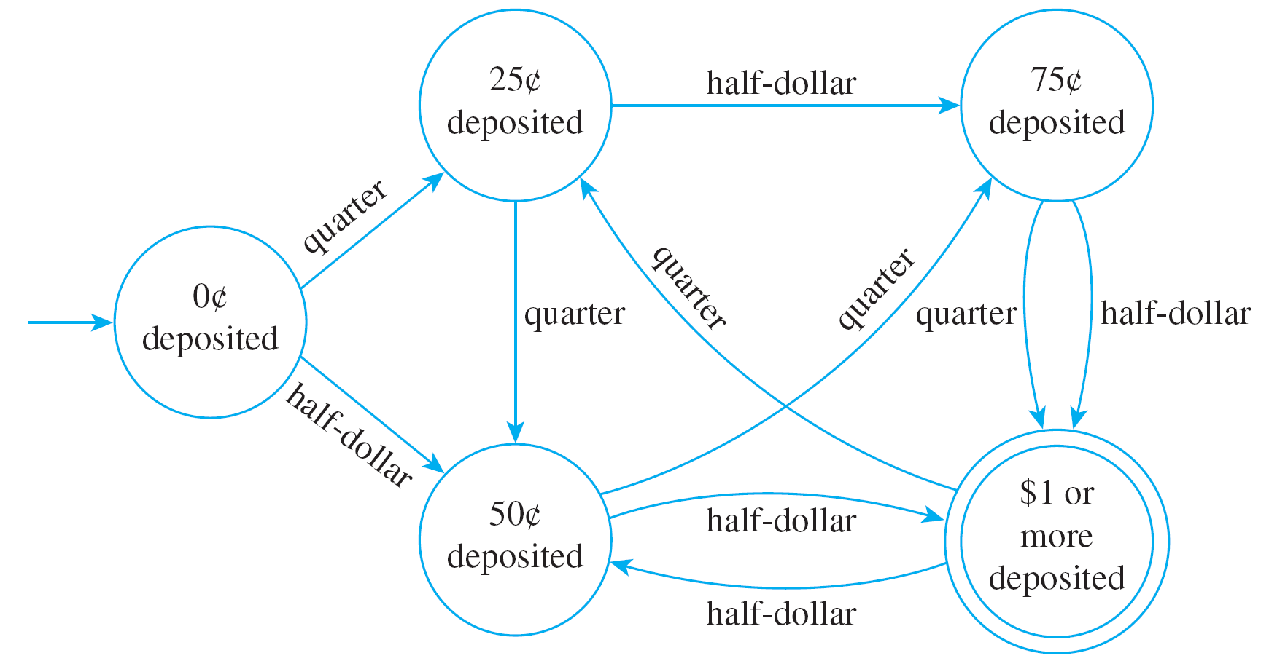
Example 1 – A Simple Vending Machine
cont’d
The operation of the machine is represented by the diagram of Figure 12.2.1.
A Simple Vending Machine
Figure 12.2.1

Slide 10
Example 1 – A Simple Vending Machine
cont’d
Each circle represents a state of the machine: the state in which 0 has been deposited, 25 , 50 , 75 , and $1 or more.
The unlabeled arrow pointing to “0 deposited” indicates that this is the initial state of the machine.
The double circle around “$1 or more deposited” indicates that a bottle of juice is released when the machine has reached this state.
(It is called an accepting state of the machine because when the machine is in this state, it has accepted the input sequence of coins as payment for juice.)

Slide 11
Example 1 – A Simple Vending Machine
cont’d
The arrows that link the states indicate what happens when a particular input is made to the machine in each of its various states.
For instance, the arrow labeled “quarter” that goes from “0 deposited” to “25 deposited” indicates that when the machine is in the state “0 deposited” and a quarter is inserted, the machine goes to the state “25 deposited.”

Slide 12
Example 1 – A Simple Vending Machine
cont’d
The arrow labeled “half-dollar” that goes from “75 deposited” to “$1 or more deposited” indicates that when the machine is in the state “75 deposited” and a half-dollar is inserted, the machine goes to the state “$1 or more deposited” and juice is dispensed.
(In this case the purchaser would pay $1.25 for the juice because the machine does not return change.)

Slide 13
Example 1 – A Simple Vending Machine
cont’d
The arrow labeled “quarter” that goes from “$1 or more deposited” to “25 deposited” indicates that when the machine is in the state “$1 or more deposited” and a quater is inserted, the machine goes back to the state “25 deposited.”
(This corresponds to the fact that after the machine has dispensed a bottle of juice, it starts operation all over again.)

Slide 14
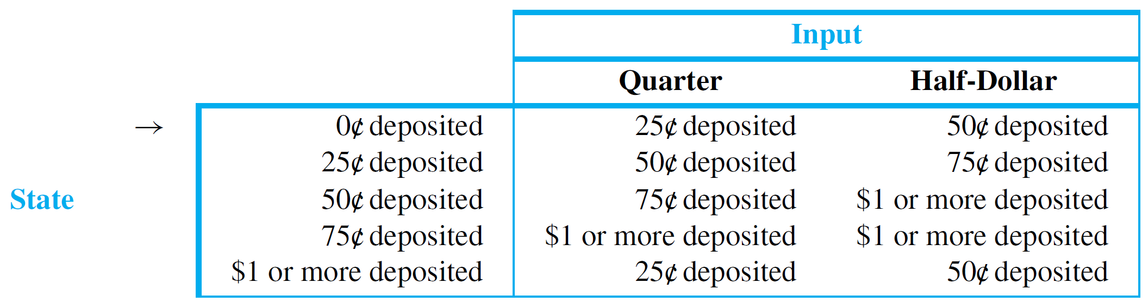
Example 1 – A Simple Vending Machine
cont’d
Equivalently, the operation of the vending machine can be represented by a next-state table as shown in Table 12.2.1.
Next-State Table
Table 12.2.1

Slide 15
Example 1 – A Simple Vending Machine
cont’d
The arrow pointing to “0 deposited” in the table indicates that the machine begins operation in this state.
The double circle next to “$1 or more deposited” indicates that a bottle of juice is released when the machine has reached this state.
Entries in the body of the table are interpreted in the obvious way.

Slide 16
Example 1 – A Simple Vending Machine
cont’d
For instance, the entry in the third row of the column labeled Half-Dollar shows that when the machine is in state “50 deposited” and a half-dollar is deposited, it goes to state “$1 or more deposited.” Note that Table 12.2.1 conveys exactly the same information as the diagram of Figure 12.2.1.
Next-State Table
Table 12.2.1

Slide 17

Example 1 – A Simple Vending Machine
cont’d
If the diagram is given, the table can be constructed; and if the table is given, the diagram can be drawn.
A Simple Vending Machine
Figure 12.2.1

Slide 18
Definition of a Finite-State
Automaton

Slide 19
Definition of a Finite-State Automaton
A general finite-state automaton is completely described by giving a set of states, together with an indication about which is the initial state and which are the accepting states (when something special happens), a list of all input elements, and specification for a next-state function that defines which state is produced by each input in each state.

Slide 20
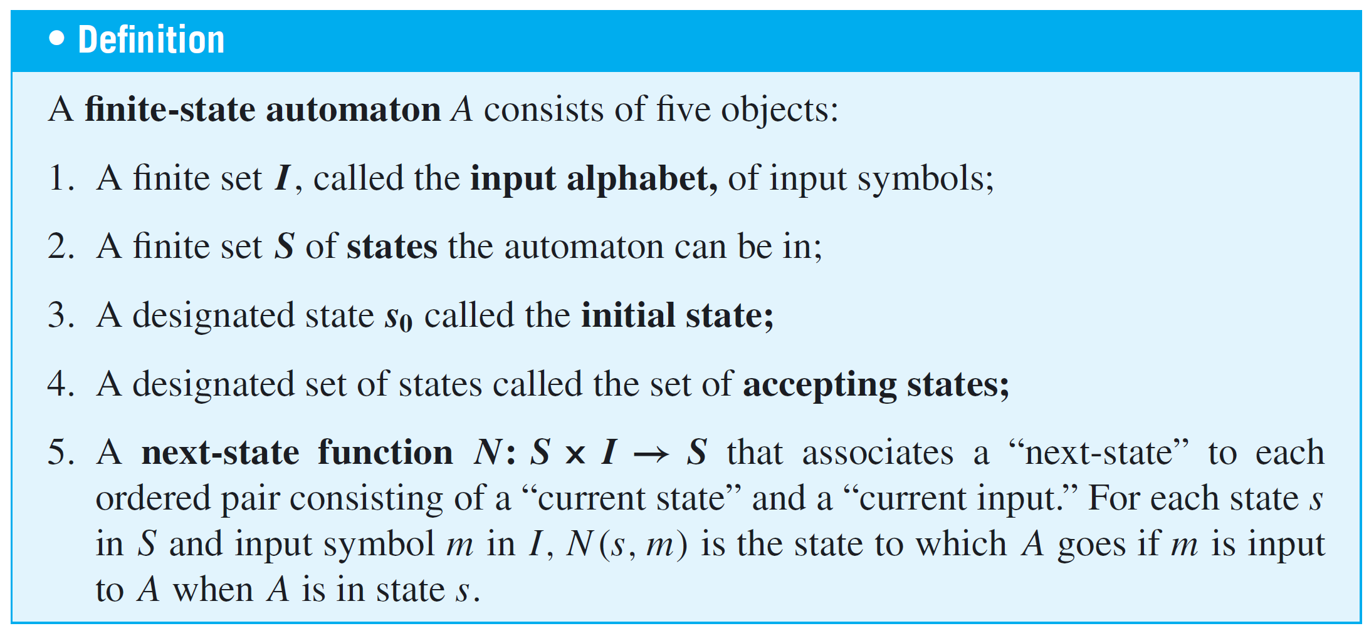
Definition of a Finite-State Automaton
This is formalized in the following definition:

Slide 21
Definition of a Finite-State Automaton
The operation of a finite-state automaton is commonly described by a diagram called a (state-)transition diagram, similar to that of Figure 12.2.1.
A Simple Vending Machine
Figure 12.2.1

Slide 22
Definition of a Finite-State Automaton
It is called a transition diagram because it shows the transitions the machine makes from one state to another in response to various inputs.
In a transition diagram, states are represented by circles and accepting states by double circles.
There is one arrow that points to the initial state and other arrows that are labeled with input symbols and point from each state to other states to indicate the action of the
next-state function.

Slide 23
Definition of a Finite-State Automaton
Specifically, an arrow from state s to state t labeled m means that N(s, m) = t.
The next-state table for an automaton shows the values of the next-state function N for all possible states s and input symbols i.
In the annotated next-state table, the initial state is indicated by an arrow and the accepting states are marked by double circles.

Slide 24
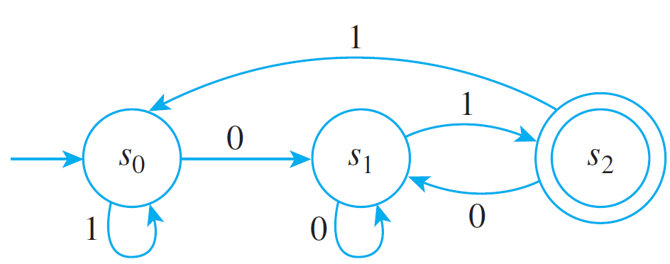
Example 2 – A Finite-State Automaton Given by a Transition Diagram
Consider the finite-state automaton A defined by the transition diagram shown in Figure 12.2.2.
a. What are the states of A?
b. What are the input symbols of A?
c. What is the initial state of A?
Figure 12.2.2

Slide 25
Example 2 – A Finite-State Automaton Given by a Transition Diagram
cont’d
d. What are the accepting states of A?
e. Determine N(s₁, 1).
f. Construct the annotated next-state table for A.
Solution:
a. The states of A are s₀, s₁, and s₂ [since these are the labels of the circles].
b. The input symbols of A are 0 and 1 [since these are the labels of the arrows].

Slide 26
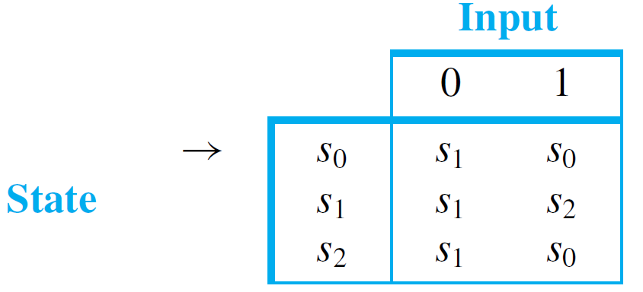
Example 2 – Solution
cont’d
c. The initial state of A is s₀ [since the unlabeled arrow points to s₀].
d. The only accepting state of A is s₂ [since this is the only state marked by a double circle].
e. N(s₁, 1) = s₂ [since there is an arrow from s₁ to s₂ labeled 1].
f.

Slide 27
The Language Accepted by
an Automaton

Slide 28
The Language Accepted by an Automaton
Now suppose a string of input symbols is fed into a
finite-state automaton in sequence.
At the end of the process, after each successive input symbol has changed the state of the automaton, the automaton ends up in a certain state, which may be either an accepting state or a nonaccepting state.
In this way, the action of a finite-state automaton separates the set of all strings of input symbols into two
subsets: those that send the automaton to an accepting state and those that do not.

Slide 29
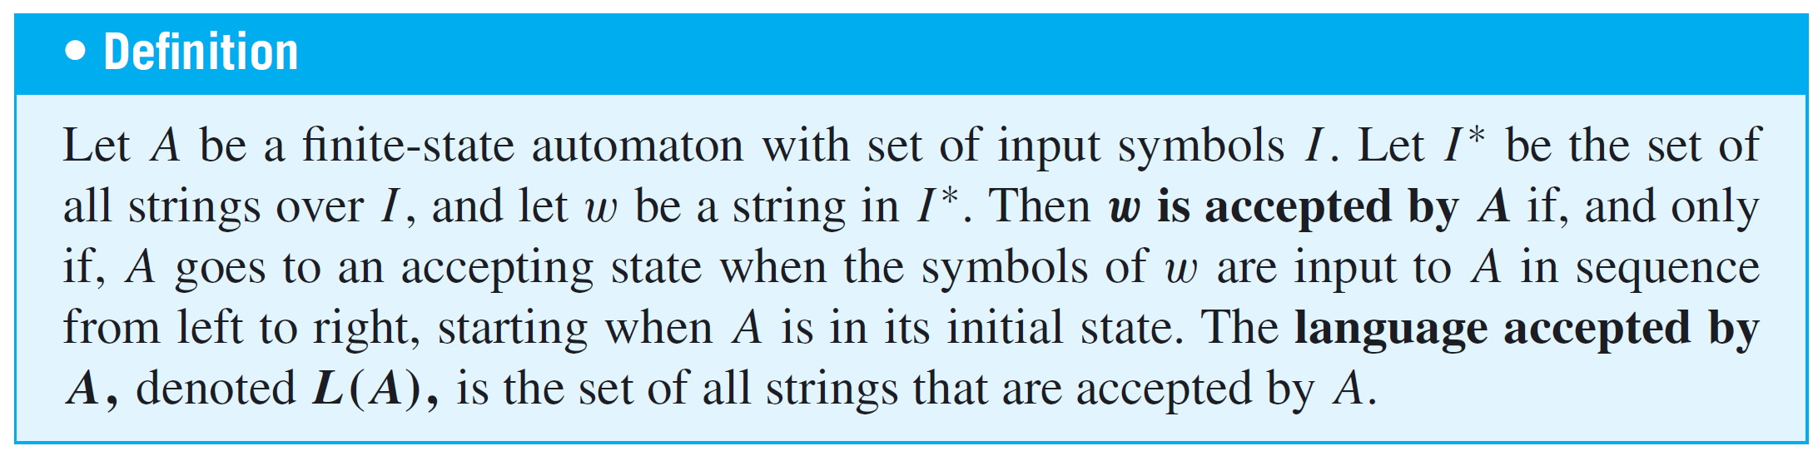
The Language Accepted by an Automaton
Those strings that send the automaton to an accepting state are said to be accepted by the automaton.

Slide 30
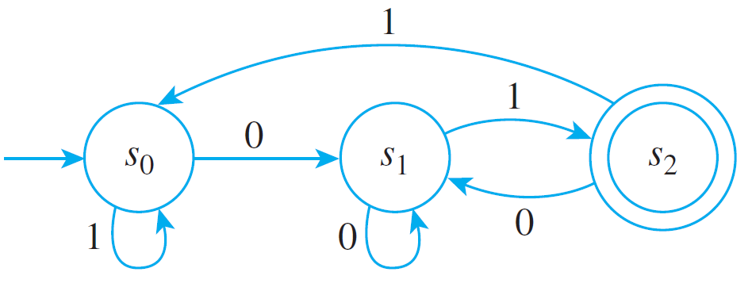
Example 4 – Finding the Language Accepted by an Automaton
Consider the finite-state automaton A shown below.
a. To what states does A go if the symbols of the following strings are input to A in sequence, starting from the initial state?
(i) 01 (ii) 0011 (iii) 0101100 (iv) 10101
b. Which of the strings in part (a) send A to an accepting state?

Slide 31
Example 4 – Finding the Language Accepted by an Automaton
cont’d
c. What is the language accepted by A?
d. Is there a regular expression that defines the same
language?
Solution:
a. (i) s₂ (ii) s₀ (iii) s₁ (iv) s₂
b. The strings 01 and 10101 send A to an accepting
state.
c. Observe that if w is any string that ends in 01, then w
is accepted by A.

Slide 32
Example 4 – Solution
cont’d
For if w is any string of length n ≥ 2, then after the first
n – 2 symbols of w have been input, A is in one of its
three states: s₀, s₁, or s₂.
But from any of these three states, input of the symbols
01 in sequence sends A first to s₁ and then to the
accepting state s₂. Hence any string that ends in 01 is
accepted by A.
Also note that the only strings accepted by A are those
that end in 01. (That is, no other strings besides those
ending in 01 are accepted by A.)

Slide 33
Example 4 – Solution
cont’d
The reason for this is that the only accepting state of A is
s₂, and the only arrow pointing to s₂ comes from s₁ and is
labeled 1.
Thus in order for an input string w of length n to send A
to an accepting state, the last symbol of w must be a 1
and the first n – 1 symbols of w must send A to state s₁.
Now three arrows point to s₁, one from each of the three
states of A, and all are labeled 0. Thus the last of the first
n – 1 symbols of w must be 0, or, in other words, the
next-to-the-last symbol of w must be 0.

Slide 34
Example 4 – Solution
cont’d
Hence the last two symbols of w must be 01, and thus
L(A) = the set of all strings of 0’s and 1’s that end in 01.
d. Yes. One regular expression that defines L(A) is
(0 | 1)∗01.

Slide 35
The Language Accepted by an Automaton
A finite-state automaton with multiple accepting states can have output devices attached to each one so that the automaton can classify input strings into a variety of
different categories, one for each accepting state.
This is how finite-state automata are used in the lexical scanner component of a computer compiler to group the symbols from a stream of input characters into identifiers, keywords, and so forth.

Slide 36
The Eventual-State Function

Slide 37
The Eventual-State Function
Now suppose a finite-state automaton is in one of its states (not necessarily the initial state) and a string of input symbols is fed into it in sequence.
To what state will the automaton eventually go? The function that gives the answer to this question for every possible combination of input strings and states of the automaton is called the eventual-state function.

Slide 38
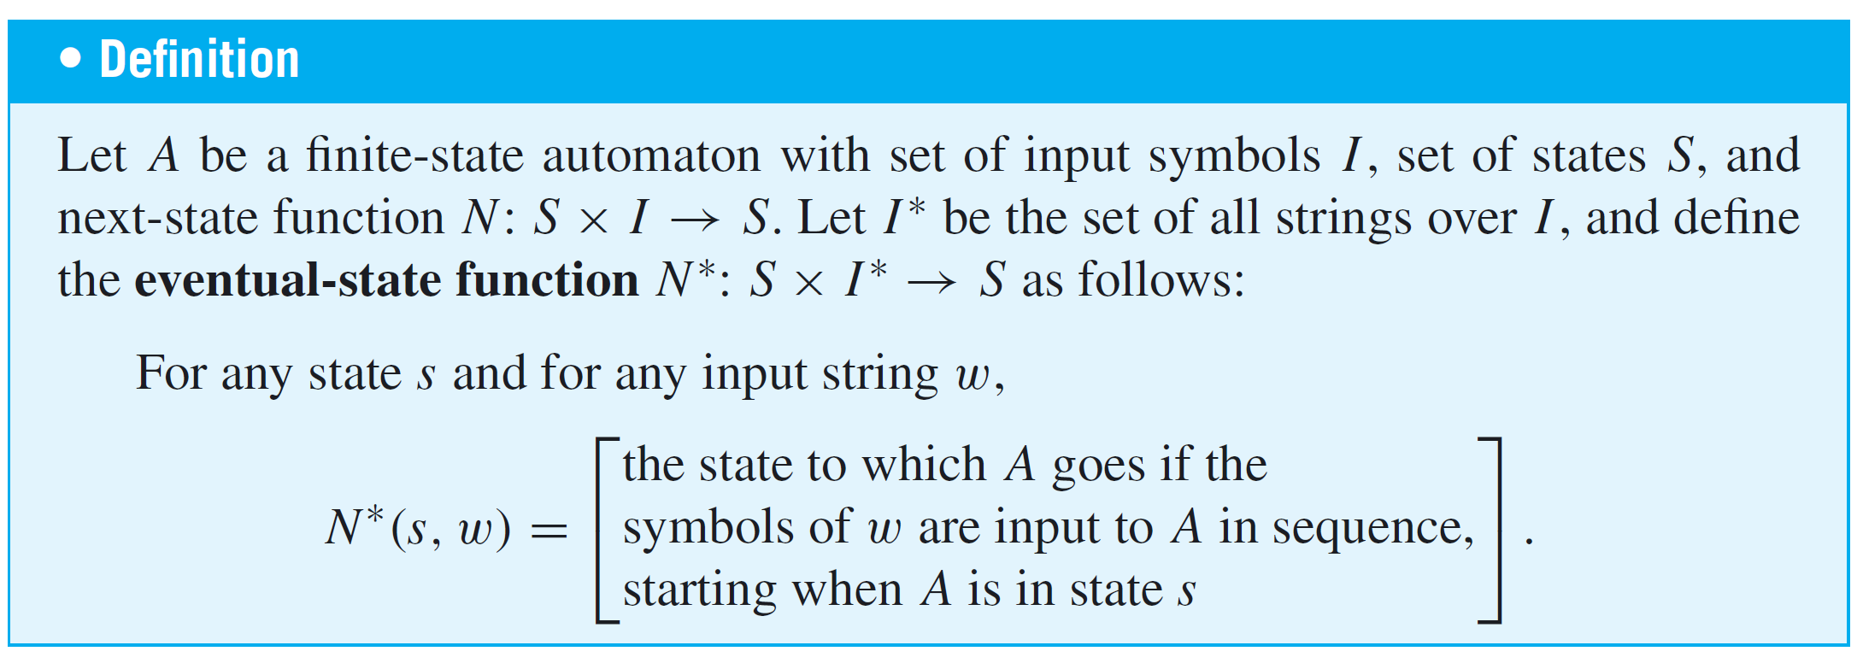
The Eventual-State Function

Slide 39
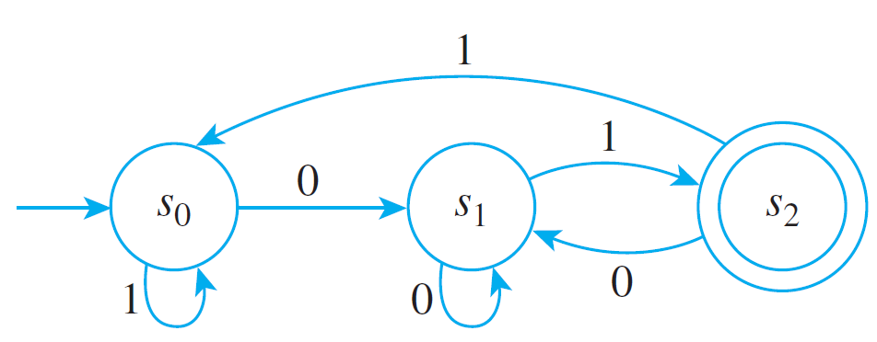
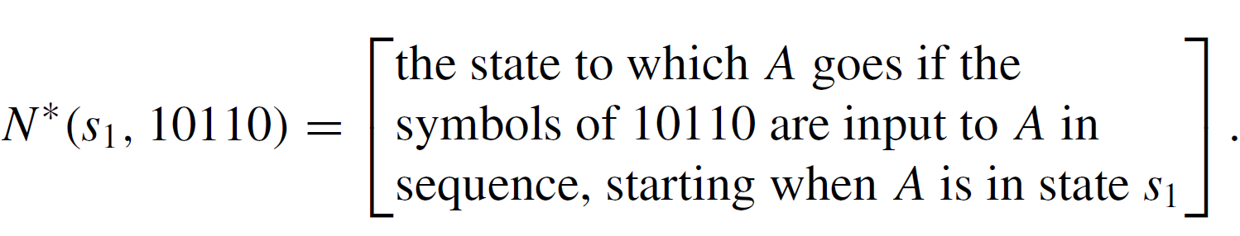
Example 5 – Computing Values of the Eventual-State Function
Consider again the finite-state automaton of Example 2 shown below for convenience. Find N∗(s₁, 10110).
Solution:
By definition of the eventual-state function,

Slide 40

Example 5 – Solution
cont’d
By referring to the transition diagram for A, you can see that starting from s₁, when a 1 is input, A goes to s₂; then when a 0 is input, A goes back to s₁; after that, when a 1 is input, A goes to s₂; from there, when a 1 is input, A goes to s₀; and finally, when a 0 is input, A goes back to s₁.
This sequence of state transitions can be written as follows:
Thus, after all the symbols of 10110 have been input in sequence, the eventual state of A is s₁, so

Slide 41
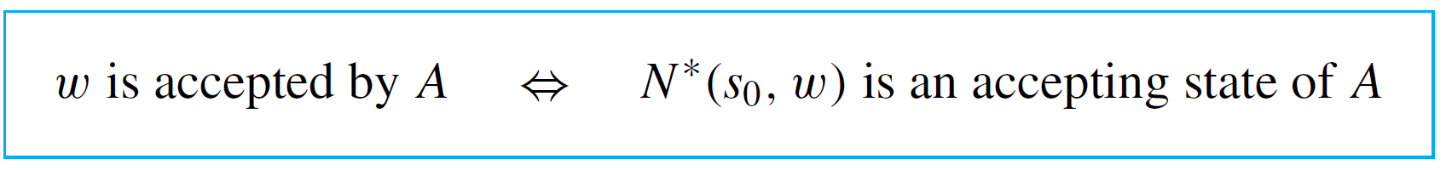
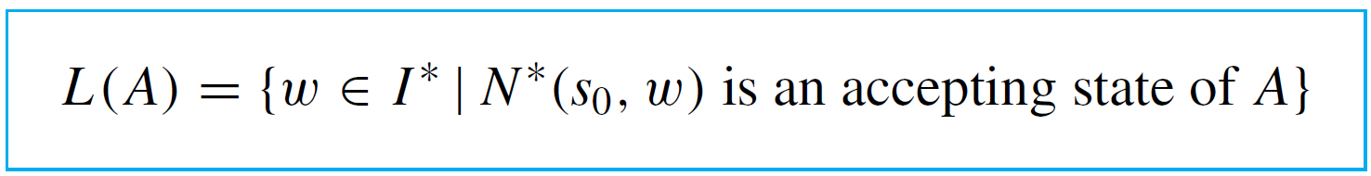
The Eventual-State Function
The definitions of string and language accepted by an automaton can be restated symbolically using the
eventual-state function.
Suppose A is a finite-state automaton with set of input symbols I and next-state function N, and suppose that I∗ is the set of all strings over I and that w is a string in I∗.

Slide 42
Designing a Finite-State
Automaton

Slide 43
Example 6 – A Finite-State Automaton That Accepts the Set of Strings of 0’s and 1’s for Which the Number of 1’s Is Divisible by 3
a. Design a finite-state automaton A that accepts the set of all strings of 0’s and 1’s such that the number of 1’s in the string is divisible by 3.
b. Is there a regular expression that defines this set?
Solution:
a. Let s₀ be the initial state of A, s₁ its state after one 1 has been input, and s₂ its state after two 1’s have been input. Note that s₀ is the state of A after zero 1’s have been input, and since zero is divisible by 3 (0 = 0·3), s₀ must be an accepting state.

Slide 44
Example 6 – Solution
cont’d
The states s₀, s₁, and s₂ must be different from one
another because from state s₀ three 1’s are needed to
reach a new total divisible by 3, whereas from state s₁
two additional 1’s are necessary, and from state s₂ just
one more 1 is required.
Now the state of A after three 1’s have been input can also be taken to be s₀ because after three 1’s have been input, three more are needed to reach a new total divisible by 3.
More generally, if 3k 1’s have been input to A, where k is any non-negative integer, then three more are needed for the total again to be divisible by 3(since 3k + 3 = 3(k + 1)).

Slide 45
Example 6 – Solution
cont’d
Thus the state in which 3k 1’s have been input, for any nonnegative integer k, can be taken to be the initial state s₀.
By similar reasoning, the states in which (3k + 1) 1’s and (3k + 2) 1’s have been input, where k is a nonnegative integer, can be taken to be s₁ and s₂, respectively.
Now every nonnegative integer can be written in one of the three forms 3k, 3k + 1, or 3k + 2, so the three states s₀, s₁, and s₂ are all that is needed to create A.

Slide 46
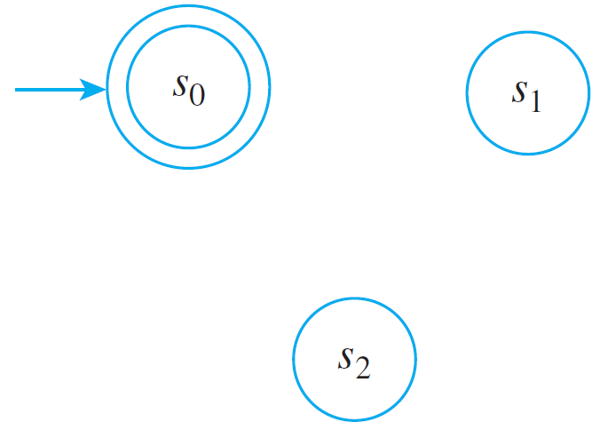
Example 6 – Solution
cont’d
Thus the states of A can be drawn and labeled as shown below.
Next consider the possible inputs to A in each of its states. No matter what state A is in, if a 0 is input the total number of 1’s in the input string remains unchanged.
Thus there is a loop at each state labeled 0.

Slide 47
Example 6 – Solution
cont’d
Now suppose a 1 is input to A when it is in state s₀. Then A goes to state s₁ (since the total number of 1’s in the input string has changed from 3k to 3k + 1).
Similarly, if a 1 is input to A when it is in state s₁, then A goes to state s₂ (since the total number of 1’s in the input string has changed from 3k + 1 to 3k + 2).
Finally, if a 1 is input to A when it is in state s₂, then it goes to state s₀ (since the total number of 1’s in the input string becomes (3k + 2) + 1 = 3k + 3 = 3(k + 1), which is a multiple of 3.)

Slide 48
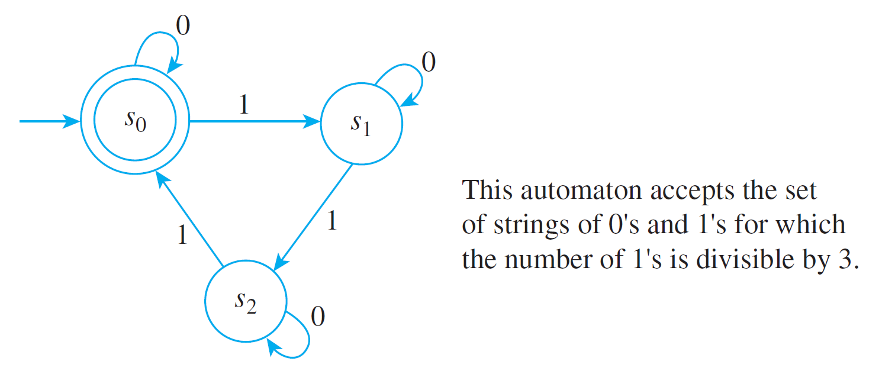
Example 6 – Solution
cont’d
It follows that the transition diagram for A has the
appearance shown below.
b. A regular expression that defines the given set is
0∗ | (0∗10∗10∗10∗)∗.

Slide 49
Simulating a Finite-State
Automaton Using Software

Slide 50
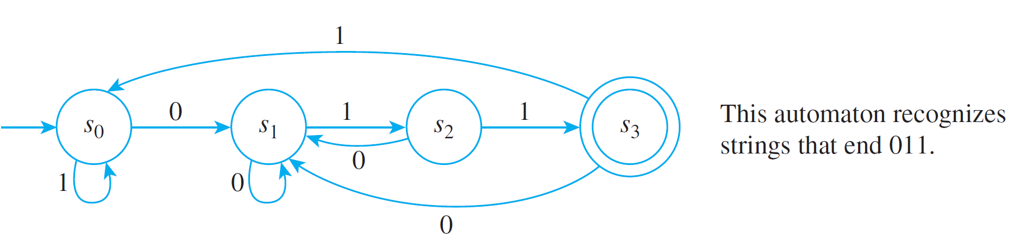
Simulating a Finite-State Automaton Using Software
Suppose items have been coded with strings of 0’s and 1’s.
A program is to be written to govern the processing of items coded with strings that end 011; items coded any other way are to be ignored. This situation can be modeled by the finite-state automaton shown in Figure 12.2.5.
Figure 12.2.5

Slide 51
Simulating a Finite-State Automaton Using Software
The symbols of the code for the item are fed into this automaton in sequence, and every string of symbols in a given code sends the automaton to one of the four states s₀, s₁, s₂, or s₃.
If state s₃ is reached, the item is processed; if not, the item is ignored.

Slide 52
Simulating a Finite-State Automaton Using Software
The action of this finite-state automaton can be simulated by a computer algorithm as given in Algorithm 12.2.1.
Algorithm 12.2.1 A Finite-State Automaton
[This algorithm simulates the action of the finite-state automaton of Figure 12.2.5 by mimicking the functioning of the transition diagram. The states are denoted 0, 1, 2, and 3.]
Input: string [a string of 0’s and 1’s plus an end marker e]

Slide 53
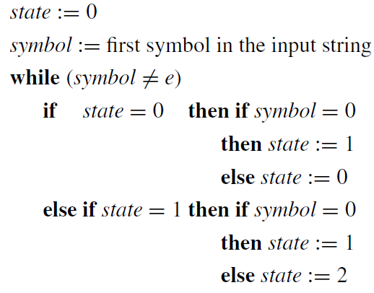
Simulating a Finite-State Automaton Using Software
Algorithm Body:

Slide 54
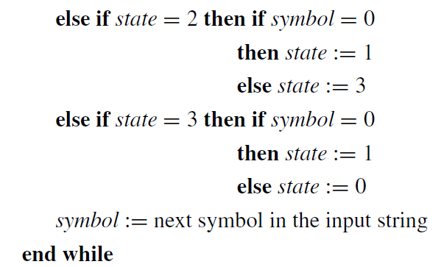
Simulating a Finite-State Automaton Using Software
cont’d

Slide 55
Simulating a Finite-State Automaton Using Software
[After execution of the while loop, the value of state is 3 if, and only if, the input string ends in 011e.]
Output: state

Slide 56
Simulating a Finite-State Automaton Using Software
An alternative way to program this automaton is to enter the values of the next-state function directly as a
two-dimensional array. This is done in Algorithm 12.2.2.

Slide 57
Simulating a Finite-State Automaton Using Software
Algorithm 12.2.2 A Finite-State Automaton
[This algorithm simulates the action of the finite-state automaton of Figure 12.2.5 by repeated application of the next-state function. The states are denoted 0, 1, 2, and 3.]
Input: string [a string of 0’s and 1’s plus an end marker e]
Figure 12.2.5

Slide 58
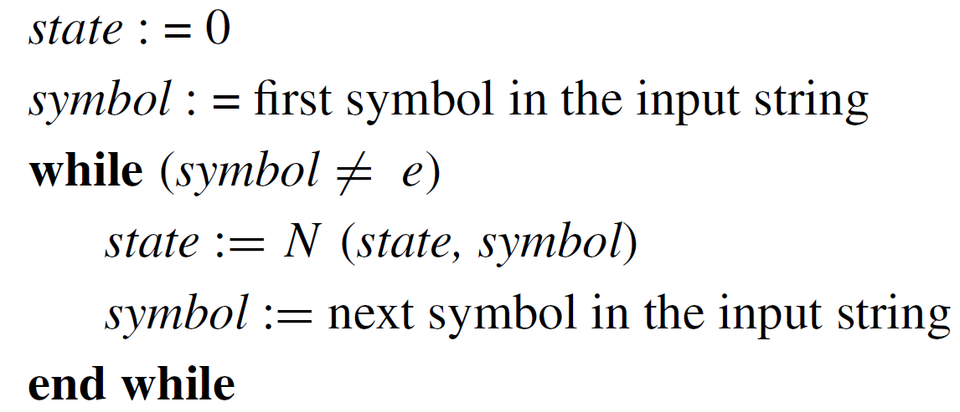
Simulating a Finite-State Automaton Using Software
Algorithm Body:
N(0, 0) := 1, N(0, 1) := 0, N(1, 0) := 1, N(1, 1) := 2,
N(2, 0) := 1, N(2, 1) := 3, N(3, 0) := 1, N(3, 1) := 0

Slide 59
Simulating a Finite-State Automaton Using Software
[After execution of the while loop, the value of state is 3
if, and only if, the input string ends in 011e.]
Output: state

Slide 60
Finite-State Automata and
Regular Expressions

Slide 61
Finite-State Automata and Regular Expressions
Each time we have considered a language accepted by a finite-state automaton, we found a regular expression that defined the same language.
Stephen Kleene showed that our ability to do this is not sheer coincidence.
He proved that any language accepted by a finite-state automaton can be defined by a regular expression and that, conversely, any language defined by a regular expression is accepted by a finite-state automaton.

Slide 62
Finite-State Automata and Regular Expressions
Thus for the many applications of regular expressions, it is theoretically possible to find a corresponding finite-state automaton.
In practice, it is often of interest to retain only pieces of the patterns sought.
For instance, to obtain a reference in an HTML document, one would specify a regular expression defining the full HTML tag, <a href= “the desired URL”>, but one would be interested in retrieving only the string between the quotation marks.

Slide 63
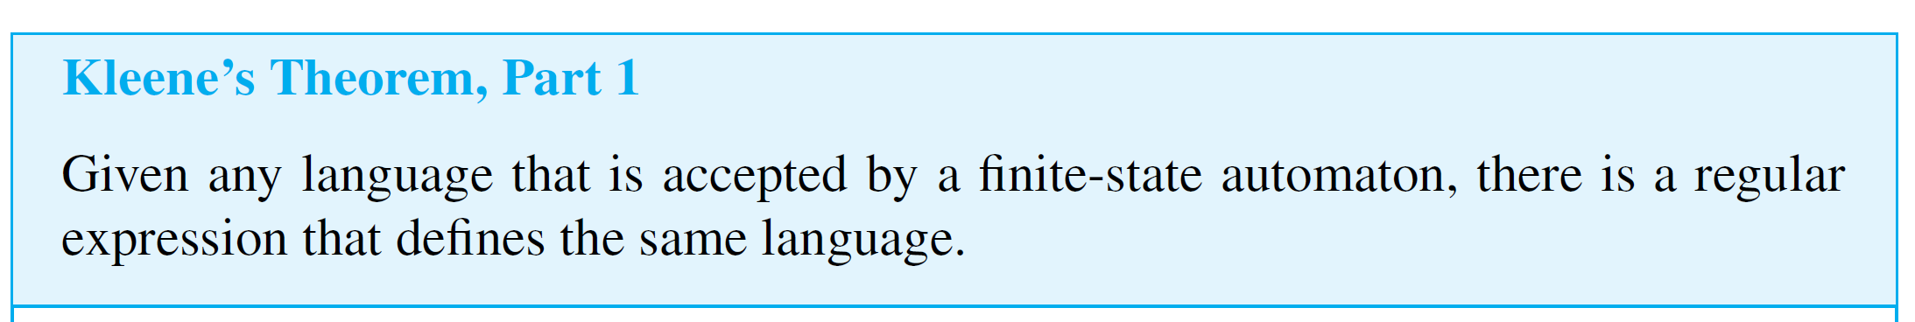
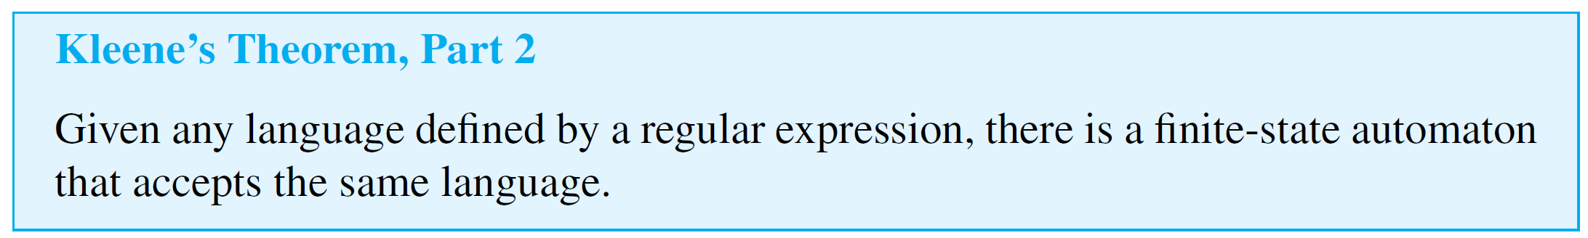
Finite-State Automata and Regular Expressions
Because of these kinds of considerations, actual implementations of finite-state automata include additional features.
We break the statement of Kleene’s theorem into two parts.

Slide 64
Regular Languages

Slide 65
Regular Languages
According to Kleene’s theorem, the set of languages defined by regular expressions is identical to the set of languages accepted by finite-state automata. Any such language is called a regular language.
The brief allusions we made earlier to context-free languages and Chomsky’s classification of languages suggest that not every language is regular. We will prove this by giving an example of a nonregular language.

Slide 66
Regular Languages
To construct the example, note that because a finite-state automaton can assume only a finite number of states and because there are infinitely many input sequences, by the pigeonhole principle there must be at least one state to which the automaton returns over and over again.
This is the essential feature of an automaton that makes it possible to find a nonregular language.

Slide 67
Example 8 – Showing That a Language is Not Regular
Let the language L consist of all strings of the form a^{k}b^{k}, where k is a positive integer. Symbolically, L is the language over the alphabet Σ = {a, b} defined by
Use the pigeonhole principle to show that L is not regular. In other words, show that there is no finite-state automaton that accepts L.

Slide 68
Example 8 – Solution
[Use a proof by contradiction.] Suppose not. That is, suppose there is a finite-state automaton A that accepts L. [A contradiction will be derived.] Since A has only a finite number of states, these states can be denoted s₁, s₂, s₃, . . . , s_{n}, where n is a positive integer.
Consider all input strings that consist entirely of a’s: a, a², a³, a⁴, . . . . Now there are infinitely many such strings and only finitely many states.
Thus, by the pigeonhole principle, there must be a state s_{m} and two input strings a^{p} and a^{q} with p ≠ q such that when either a^{p} or a^{q} is input to A, A goes to state s_{m}.

Slide 69
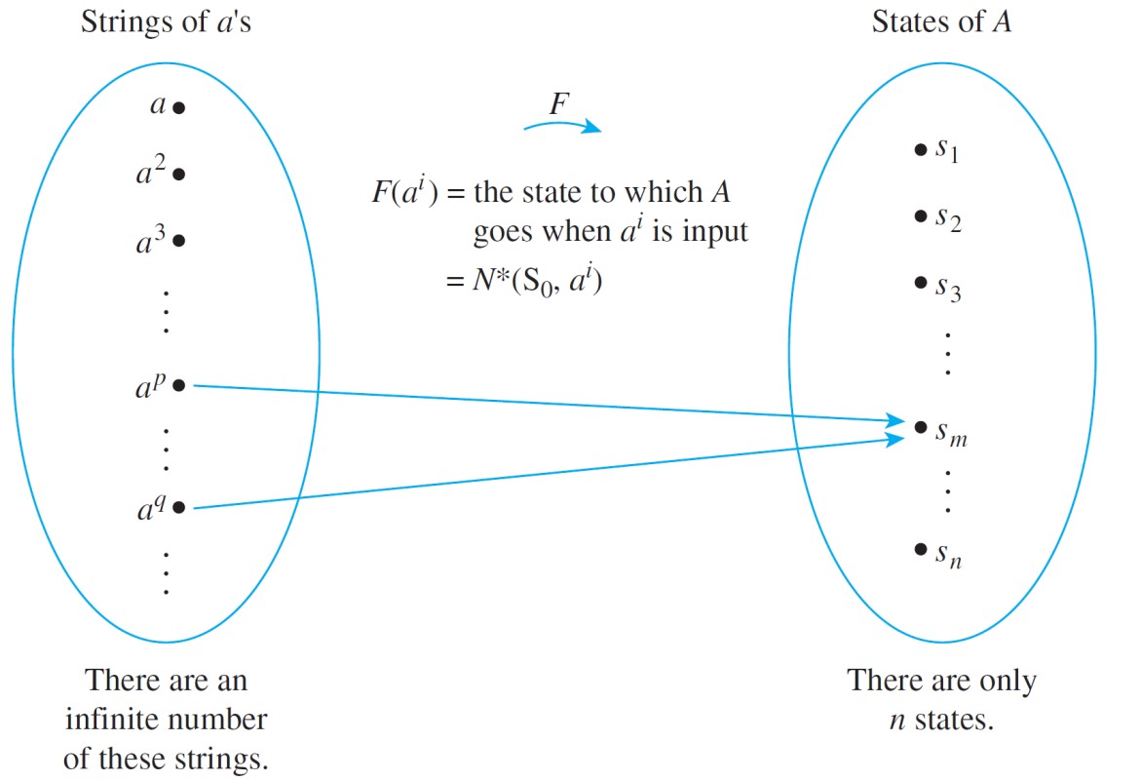
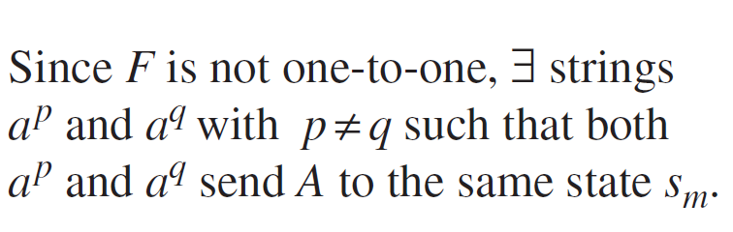
Example 8 – Solution
cont’d
See Figure 12.2.6. [The pigeons are the strings of a’s, the pigeonholes are the states, and the correspondence associates each string with the state to which A goes when the string is input.]
Figure 12.2.6

Slide 70
Example 8 – Solution
cont’d
Now, by supposition, A accepts L. Hence A accepts the string
a^{p}b^{p}.
This means that after p a’s have been input, at which point A is in state s_{m}, inputting p additional b’s sends A into an accepting state, say s_{a}. But that implies that
a^{q}b^{p}
also sends A to the accepting state s_{a}, and so a^{q}b^{p} is accepted by A.

Slide 71
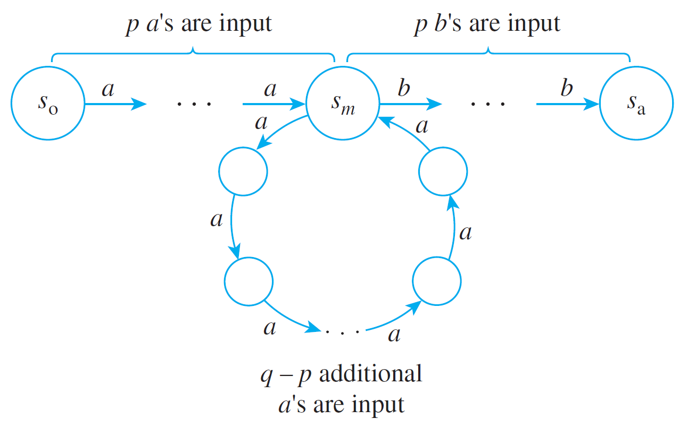
Example 8 – Solution
cont’d
The reason is that after q a’s have been input, A is also in state s_{m}, and from that point, inputting p additional b’s sends A to state s_{a}, which is an accepting state.
Pictorially, if p < q, then

Slide 72
Example 8 – Solution
cont’d
Now, by supposition, L is the language accepted by A. Thus since s is accepted by A, s ∈ L. But by definition of L, L consists only of strings with equal numbers of a’s and b’s. So since p ≠ q, s ∉ L.
Hence s ∈ L and s ∉ L, which is a contradiction.
It follows that the supposition is false, and so there is no finite-state automaton that accepts L.

